Slide 1






Enhanced environmental protection inspection for efficient control of air quality monitoring and of all entities under obligation within system of greenhouse gas emission allowance trading, in order to achieve better quality of air in Republic of Croatia
This project is funded by the European Union

Slide 2



THEME 7: DATA MANAGEMENT
Energy Research and Environmental Protection Institute
Bojan Abramović dipl. ing. stroj.
Predrag Hercog, dipl. inž. medicinske biokemije

Slide 3

7.1 DATA FLOW
A process that involves creating targeted quality data from raw measuring data generated by each automatic instrument is called data management.
Energy Research and Environmental Protection Institute

Slide 4
7.1 DATA FLOW
The measuring data
Each instrument in the air quality monitoring network continuously (every second) monitors the concentrations of pollutants that it measures. From these data in computers or data loggers, 10 or 15-minute average values of concentrations are generated.
These measurement values are called raw values of the first averaging time.
Energy Research and Environmental Protection Institute

Slide 5
7.1 DATA FLOW
By averaging these values for one hour (if the requirements of 75% of data are met by regulation) raw measurement values of hourly averaging time and basic raw measurement values are obtained.
These values are then electronically transferred to a central supervisory computer where each one is validated individually and valid hourly values of the concentration of individual pollutants are obtained.
Energy Research and Environmental Protection Institute

Slide 6
7.1 DATA FLOW
Also, raw hourly values with certain electronic filters can be published online on the WEB site. Validated data are then averaged to higher time of averaging (8-hours sliding, 24-hours sliding and annual averaging times), and the validation values of higher averaging times are obtained. These values are periodically reviewed again and subsequently ratified or confirmed by the laboratory ratification report.
Energy Research and Environmental Protection Institute

Slide 7
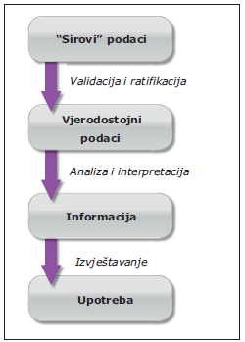
7.1 DATA FLOW
Such ratified data is the ultimate data. Due to their quality and validity, the lab that performs measurements in a particular network is guaranteed.
The statistical processing of the data obtained (prescribed by regulation) for a period of at least one year shall be the final data on air quality in the form of an annual report. The flow of data on air quality monitoring is shown in Figure 1.
Energy Research and Environmental Protection Institute

Slide 8
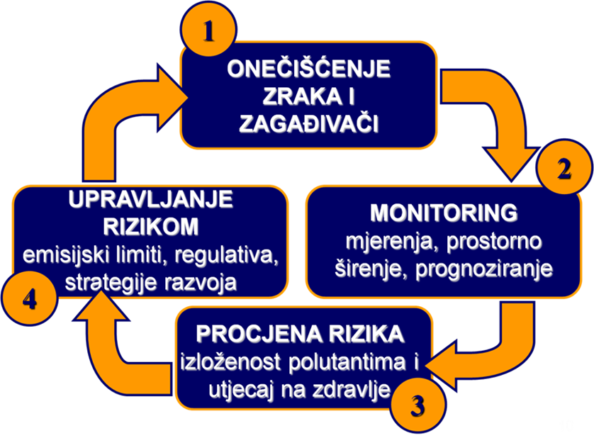
7.1 DATA FLOW (RELATED TO TOXICOLOGICAL AND PUBLIC HEALTH ASPECTS, RISK ASSESSMENT AND Regulation on the LEVEL of POLLUTANTS CONCENTRATION IN THE AIR)
One of the most important aspects of the use of this data is an estimate of the risk of air pollution for the purpose of the management of the same.
Energy Research and Environmental Protection Institute

Slide 9
7.1 DATA FLOW (RELATED TO TOXICOLOGICAL AND PUBLIC HEALTH ASPECTS, RISK ASSESSMENT AND Regulation on the LEVEL of POLLUTANTS CONCENTRATION IN THE AIR)
It is important to know that the ambient (imission) concentration of pollutants, considered strictly, do not represent an acute danger to human health, even at levels of limit values. However, they may be dangerous in the case of longterm exposure, especially for risk groups. Due to the specific form of absorption into the body (respiratory mucous membrane) groups with the highest risk are the pulmonary patients and primarily asthmatics and patients with chronic obstructive pulmonary disease (KOPB). Next, there are cardiac patients, and then children.
Energy Research and Environmental Protection Institute

Slide 10
7.1 DATA FLOW (RELATED TO TOXICOLOGICAL AND PUBLIC HEALTH ASPECTS, RISK ASSESSMENT AND Regulation on the LEVEL of POLLUTANTS CONCENTRATION IN THE AIR)
Thus, for example, the APHEA study 1 links episodes of higher NO2 concentrations with increased admissions to COPB and asthma patients, especially in children. Growth of mortality with rising concentrations of floating particles is significantly higher in cities with higher NO2 concentrations, which is explained by the synergistic effect or the origin of floating particles (traffic) that indicate high NO2 concentrations (WHO). Research in London have shown a correlation of a number of visits to the family doctor of the children with asthma and increased NO2 concentration (Fusco et al. 2001).
Energy Research and Environmental Protection Institute

Slide 11
7.1 DATA FLOW (RELATED TO TOXICOLOGICAL AND PUBLIC HEALTH ASPECTS, RISK ASSESSMENT AND Regulation on the LEVEL of POLLUTANTS CONCENTRATION IN THE AIR)
APHEA 2 correlates the increase in PM10 concentrations by 10 μg / m3 on average in major European cities with 0.65% increase in mortality and 1 - 1.2% by increasing in hospital admissions to chronic lung disease patients (increased episodes of high pollution with PM10 above 100 μg / m3 can last for a whole month !!!).
Pekkanen et al. 2002, have been investigating in three european cities, an increase in PM2.5 concentration with enhanced ST segment depression as a marker of myocardial ischemia.
Energy Research and Environmental Protection Institute

Slide 12
7.1 DATA FLOW (RELATED TO TOXICOLOGICAL AND PUBLIC HEALTH ASPECTS, RISK ASSESSMENT AND Regulation on the LEVEL of POLLUTANTS CONCENTRATION IN THE AIR)
The EEA estimates in its report "Air Quality in Europe - 2016 Report" that, in 2013, 4820 premature deaths in the Republic of Croatia can be attributed to air pollution by floating particles, 260 ozone and 160 nitrogen dioxide.
Energy Research and Environmental Protection Institute

Slide 13

7.1 DATA FLOW (RELATED TO TOXICOLOGICAL AND PUBLIC HEALTH ASPECTS, RISK ASSESSMENT AND Regulation on the LEVEL of POLLUTANTS CONCENTRATION IN THE AIR)
From this data can be seen the risk to which the population is exposed.
Energy Research and Environmental Protection Institute

Slide 14
7.1 DATA FLOW (RELATED TO TOXICOLOGICAL AND PUBLIC HEALTH ASPECTS, RISK ASSESSMENT AND Regulation on the LEVEL of POLLUTANTS CONCENTRATION IN THE AIR)
One of the ways of risk management is to set air quality standards. In the Republic of Croatia this is regulated by the Regulation on the level of pollutants concentration (OG 117/12).
Energy Research and Environmental Protection Institute

Slide 15
7.1 DATA FLOW (RELATED TO TOXICOLOGICAL AND PUBLIC HEALTH ASPECTS, RISK ASSESSMENT AND Regulation on the LEVEL of POLLUTANTS CONCENTRATION IN THE AIR)
This Regulation lays down limit values (LV) and target values (TV) for certain pollutants in the air, long-term objectives and target values for ground-level ozone in the air, depending on the properties of pollutants, upper and lower assessment thresholds, tolerance limits (TL), target values, basic constituents of said values, PM2.5 average exposure indicator, targeted exposure reduction at national level, exposure concentration, critical level, alert threshold, alert threshold, special measures for the protection of human health and deadlines for progressively reducing tolerance limits and for achieving target values for ground-level ozone.
Energy Research and Environmental Protection Institute

Slide 16
7.1 DATA FLOW (RELATED TO TOXICOLOGICAL AND PUBLIC HEALTH ASPECTS, RISK ASSESSMENT AND Regulation on the LEVEL of POLLUTANTS CONCENTRATION IN THE AIR)
The Regulation also lays down limit values (GVs) for the protection of human health, quality of life, vegetation and ecosystem protection, distribution and number of metering points based on an indicator of average exposure to PM2.5 and which adequately reflects general population exposure.
Energy Research and Environmental Protection Institute

Slide 17
7.1 DATA FLOW (RELATED TO TOXICOLOGICAL AND PUBLIC HEALTH ASPECTS, RISK ASSESSMENT AND Regulation on the LEVEL of POLLUTANTS CONCENTRATION IN THE AIR)
The concentration limit values of pollutants in the air due to the protection of the health of the people
Onečišćujuća tvar | Vrijeme usrednjavanja | Granična vrijednost (GV) | Učestalost dozvoljenih prekoračenja
Sumporov dioksid (SO₂) | 1 sat | 350 µg/m³ | GV ne smije biti prekoračena više od 24 puta tijekom kalendarske godine
 | 24 sata | 125 µg/m³ | GV ne smije biti prekoračena više od 3 puta tijekom kalendarske godine
Dušikov dioksid (NO₂) | 1 sat | 200 µg/m³ | GV ne smije biti prekoračena više od 18 puta tijekom kalendarske godine
 | kalendarska godina | 40 µg/m³ | -
Ugljikov monoksid (CO) | maksimalna dnevna osmosatna srednja vrijednost | 10 mg/m³ | -
PM₁₀ | 24 sata | 50 µg/m³ | GV ne smije biti prekoračena više od 35 puta tijekom kalendarske godine
 | kalendarska godina | 40 µg/m³ | -
Benzen | kalendarska godina | 5 µg/m³ | -
Olovo (Pb) u PM₁₀ | kalendarska godina | 0,5 µg/m³ | -
Ukupna plinovita živa (Hg) | kalendarska godina | 1 µg/m³ | -
Energy Research and Environmental Protection Institute

Slide 18
7.1 DATA FLOW (RELATED TO TOXICOLOGICAL AND PUBLIC HEALTH ASPECTS, RISK ASSESSMENT AND Regulation on the LEVEL of POLLUTANTS CONCENTRATION IN THE AIR)
Limit value for PM2, 5 in regard to the protection of the health of the people
Vrijeme usrednjavanja | Granična vrijednost (GV) | Granica tolerancije (GT) | Datum do kojeg treba postići graničnu vrijednost
1. STUPANJ
Kalendarska godina | 25 µg/m³ | 20% na datum 11. lipnja 2008. godine, s tim da se sljedećeg 1. siječnja i svakih 12 mjeseci nakon toga, smanjuje za jednake godišnje postotke, kako bi se do 1. siječnja 2015. godine dostiglo 0% | 1. siječnja 2015. godine
2. STUPANJ
Kalendarska godina | 20 µg/m³ |  | 1. siječnja 2020. godine
Energy Research and Environmental Protection Institute

Slide 19
7.1 DATA FLOW (RELATED TO TOXICOLOGICAL AND PUBLIC HEALTH ASPECTS, RISK ASSESSMENT AND Regulation on the LEVEL of POLLUTANTS CONCENTRATION IN THE AIR)
The concentration limit values of pollutants in the air with regard to the quality of life (disruption by smell)
Onečišćujuća tvar | Vrijeme usrednjavanja | Granična vrijednost (GV) | Učestalost dozvoljenih prekoračenja
Sumporovodik (H₂S) | 1 sat | 7 µg/m³ | GV ne smije biti prekoračena više od 24 puta tijekom kalendarske godine
 | 24 sata | 5 µg/m³ | GV ne smije biti prekoračena više od 7 puta tijekom kalendarske godine
Merkaptani | 24 sata | 3 µg/m³ | GV ne smije biti prekoračena više od 7 puta tijekom kalendarske godine
Amonijak (NH₃) | 24 sata | 100 µg/m³ | GV ne smije biti prekoračena više od 7 puta tijekom kalendarske godine
Metanal (formaldehid) | 24 sata | 30 µg/m³ | –
Energy Research and Environmental Protection Institute

Slide 20
7.2 DATA VALIDATION
WHAT DATA ARE NEEDED?
Data on hourly averages of concentrations of pollutants in air monitored by air quality monitoring stations according to network design represents the basic source of data required for reporting and information exchange in accordance with the regulations of the Republic of Croatia and the EU. As such, they must be valid, i.e. checked (validated).
Energy Research and Environmental Protection Institute

Slide 21
7.2 DATA VALIDATION
Validation is necessarily performed on a continuous basis, best daily for the past 24 hours. The following provisions of Annex III (Data validation procedure and quality codes) of Decision EC 97/101 / EC, in accordance with HRN EN ISO / IEC 17025 and Decisions 97/101 and 01/752, validation of the data is performed on the basis of QA / QC measurement plan as well as critical and logical verification of measuring data.
The procedure consists of:
• checking the technical correctness of the instruments and measuring systems
• checking the fulfilling the criteria of measurement
quality control
• the critical and logical verification of the measuring data.
Energy Research and Environmental Protection Institute

Slide 22
7.2 DATA VALIDATION
These activities are most commonly performed on a daily basis for the last 24 hours on a central computer network with the help of database data and direct modem access to computers or data loggers in each particular network station.
Such databases most often consist of all the measuring, QC, and service data on a network that regularly fills in with the latest data from the station. It is desirable to document the verification results.
Energy Research and Environmental Protection Institute

Slide 23
7.2 DATA VALIDATION
CHECKING THE STATUS OF THE TECHNICAL CORRECTNESS OF THE MEASURING EQUIPMENT
The instrument status check is performed via a direct modem connection between the central computer and the local computer in a verified station. The local computer is connected to all relevant components of the measuring system of the station. This enables insight into the technical validity of the device in accordance with the software application and protocols set by the equipment manufacturer.
Energy Research and Environmental Protection Institute

Slide 24
7.2 DATA VALIDATION
If any instrument in its technical status shows an error, it means that the operation of the instrument significantly deviates from normal and that the data collected in the period since the appearance of such status can not be taken as valid. Likewise, the appearance of a technical error status on the instrument requires an emergency servicing intervention.
Energy Research and Environmental Protection Institute

Slide 25
7.2 DATA VALIDATION
checking the application of STANDARD OF MEASUREMENT QUALITY CONTROL
All measuring devices within the QC measurements should have an automatic periodic (usually every 25 hours) check of zero and span gas (substance concentration in the amount of 80% of the maximum metering area), so-called "zero" and "span" checks.
In accordance with the given standards, each check will be marked (usually E - error) if the verification results exceed the default acceptance limit set by the working procedure for each method.
Energy Research and Environmental Protection Institute

Slide 26
7.2 DATA VALIDATION
If a sufficiently long period is observed, such an examination is sufficient to gain insight into whether there is any significant trend in the change of results, while the last data is about the actual functionality of the instrument.
All significant deviations of the zero and span results represent information about the existence of a functional problem in the work of the instrument, which may result in a decrease in the accuracy of the metering data. This data needs to be further observed with special care and the instrument needs to be technically and / or functionally checked.
Energy Research and Environmental Protection Institute

Slide 27
7.2 DATA VALIDATION
CRITICAL AND LOGICAL VERIFICATION OF MEASUREMENT DATA
Critical and logical data verification is a validation of data, taking into account all the parameters that may point to the validity of data such as exceptionally high results, results that are too fast to change, results that deviate significantly from what is expected under certain conditions (meteorological, traffic, location, etc.). It also takes into account comparison with previous measurements at similar conditions and measurements of other pollutants as well as measurements from other (nearby) stations in network. Generally, this procedure is the use of all knowledge, knowledge and experience in the area of air quality with the aim of providing a better quality assessment of data.
Energy Research and Environmental Protection Institute

Slide 28
7.2 DATA VALIDATION
Measurement data that goes through all of the above-mentioned verification procedures are called valid data. As such, they are stored in a database of validated data.
Original raw data should also be kept in the raw data base.
Energy Research and Environmental Protection Institute

Slide 29
7.2 DATA VALIDATION
DETERMINING STATUS OF VALIDITY OF MEASUREMENT DATA
The validation of the measurement data is done in the validation lists based on the validation procedure described above, in accordance with Annex III of Decision EC 97 / 101EC. All invalid data are marked with the letter N behind the numeric values for a specific data. Deselected values are considered to be valid.
Energy Research and Environmental Protection Institute

Slide 30
7.3 DATA RATIFICATION
Ratification of data represents a final check and authorization of all data on the air quality monitoring in a network by the testing laboratory.
Final ratification of data often requires a set of measurement data over a longer period of time than the one observed during data validation. For example, sometimes even after careful validation of the data, certain facts can be found that can convert valid data to the invalid, and vice versa.
Energy Research and Environmental Protection Institute

Slide 31
7.3 DATA RATIFICATION
This process involves collecting and merging metadata, valid measuring data and measuring quality data into a ratification report that is submitted to the owner or network coordinator periodically for a period of 1 to 6 months.
In this report, the network owner with authorized measuring data will also receive information about the status of the network over a certain period of time, in all unusual situations, and data on data coverage.
Energy Research and Environmental Protection Institute

Slide 32
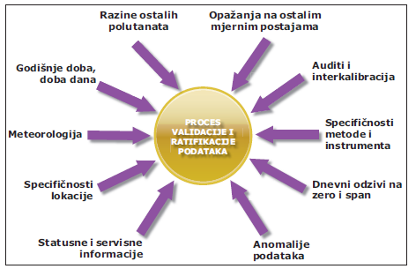
7.3 DATA RATIFICATION
The process of validation and ratification of data is described in Figure 2.
Energy Research and Environmental Protection Institute

Slide 33
7.3 DATA RATIFICATION
Reporting
Air Quality Reporting is the obligation of all owners or users of air quality monitoring stations in the Republic of Croatia.
So here we will give a practical example of the content of an annual report prepared in accordance with the RH regulations.
and on each lab is that within the legal and normative obligations defined designs its report. Each laboratory needs to design its report, within legally and normatively defined obligations.
Energy Research and Environmental Protection Institute

Slide 34
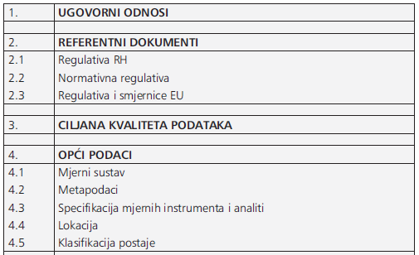
7.3 DATA RATIFICATION
Energy Research and Environmental Protection Institute

Slide 35
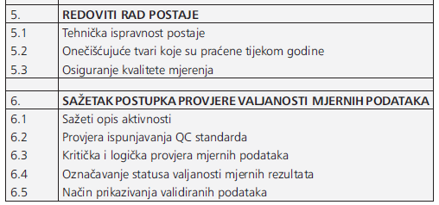
7.3 DATA RATIFICATION
Energy Research and Environmental Protection Institute

Slide 36
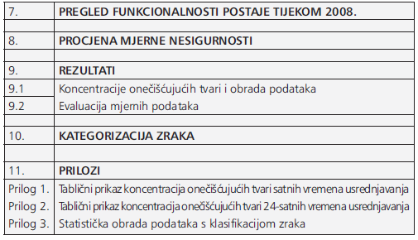
7.3 DATA RATIFICATION
Energy Research and Environmental Protection Institute

Slide 37
THANK YOU FOR YOUR ATTENTION
Energy Research and Environmental Protection Institute
  Disclaimer: The contents of this publication are the sole responsibility of EKONERG – Energy Research and Environmental Protection Institute, Ltd. and can in no way be taken to reflect the views of the European Union
This project is funded by the European Union

